Slide 1
NEURO INSIGHT
Areej
Hira Amanat
2021-SE-13
2021-SE-19
Supervisor: Dr. Irfan Yousuf
Co-Supervisor: Waqas Ali Zafar

Slide 2
Introduction
Epilepsy: Epilepsy is one of the most common neurological disorders, affecting over 50 million people globally. It is characterized by sudden and unpredictable seizures, which can disrupt a person’s daily life and pose severe risks if not managed effectively.
Objectives:
Automated Diagnosis: Develop a deep learning-based application for accurate epilepsy diagnosis using EEG signals.
Educational Tool: Aid young doctors in learning to diagnose epilepsy by comparing their analyses with system findings.
Local Focus: Collect and utilize locally-sourced EEG data to ensure relevance to the target demographic

Slide 3
Literature Review/Related Work
Related System | Description | Limitations | Project Solution
Epsy[1] | Epsy is a digital health platform for tracking and managing epilepsy, including seizures, medications, and overall health. | Not detect seizures in real-time. | Our system enables real-time data collection and automatic detection
My Seizure Diary[2] | My Seizure Diary helps track and manage epilepsy seizures. | Not detect seizures in real-time. | Add real-time detection to enhance user experience.
Seizure Tracker [3] | Seizure Tracker is an easy-to-use app for monitoring seizures and identifying patterns | Not detect seizures in real-time | Implement real-time detection for immediate seizure monitoring.

Slide 4
Problem Statement
The current methods for diagnosing epilepsy through manual EEG analysis are inefficient, labor-intensive, and prone to error. Existing automated systems often rely on online benchmark data that does not accurately represent the diverse demographics of patients, limiting their effectiveness.

Slide 5
Scope/Features
Neuro Insight aims to develop a comprehensive system that leverages deep learning models for epilepsy detection and management. This project will focus on improving the accuracy and efficiency of seizure detection and prediction, ultimately leading to enhanced patient care and improved quality of life.
Real-time seizure detection and prediction
Automated diagnosis using deep learning models
Educational tool for young doctors
Data visualization and insights for patient care

Slide 6
Methodology/Architecture
Data Acquisition Collaborate with local hospitals to gather EEG recordings from epilepsy patients
Data Preprocessing Apply filtering, segmentation, and normalization techniques to prepare EEG signals
Feature Extraction Utilize time-domain, frequency-domain, and time-frequency features to capture EEG patterns
Model Development Implement deep learning models (RNNs, LSTMs) for automated feature extraction and classification

Slide 7
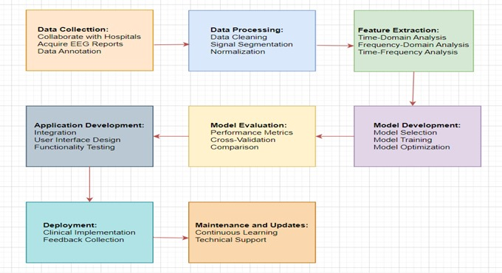
Methodology/Architecture

Slide 8
Data Collected
Primary Source Partner with Mayo and Shalamar Hospital's neurology department in Lahore for EEG recordings from epilepsy patients
Data Labeling Collaborate with specialist doctors to annotate EEG data, ensuring accurate labeling of seizure phases
Ethical Compliance Obtain informed consent and adhere to ethical standards in data collection and handling
Quality Assurance Implement continuous monitoring and expert validation to maintain data quality and relevance

Slide 9
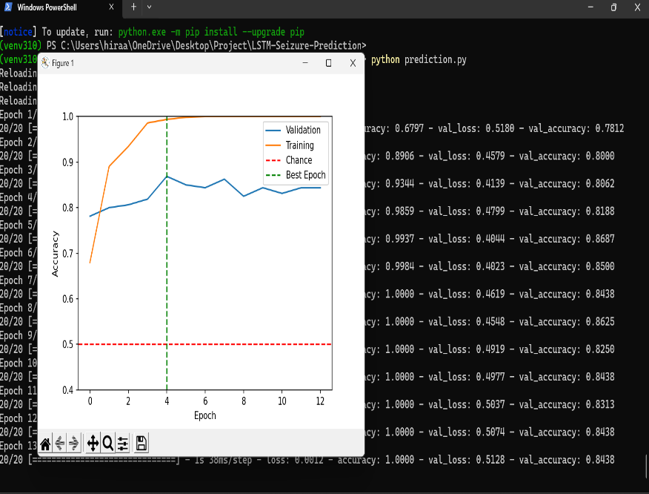
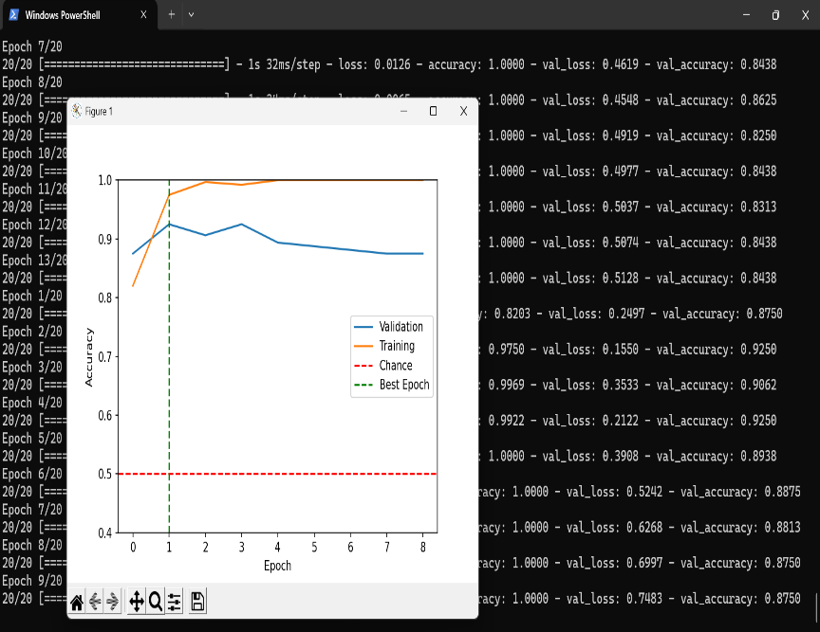
Initial Results
Our initial work focuses on a binary classification task: determining whether a patient is experiencing a seizure or not.
Preliminary results show the deep learning models successfully distinguish between seizure and non-seizure EEG data, providing a foundational step towards more advanced seizure detection and prediction.

Slide 10
Remaining Work
Complete

Slide 11
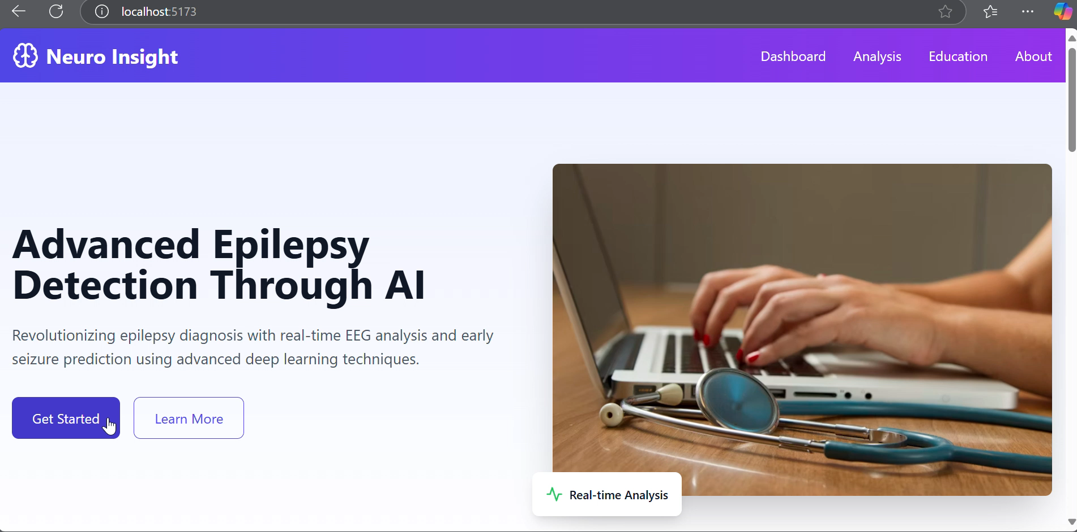
Practical Demonstration

Slide 12
References
[1] Epsy. https://www.epsy.com. A digital health platform that helps people with epilepsy track and manage their seizures, medications, and overall health [2] My seizure diary. https://www.myseizurediary.com. A comprehensive digital diary that allows users to record and manage their seizures.
[3] Seizure tracker. https://www.seizuretracker.com. An app designed to assist individuals with epilepsy in monitoring their seizures and identifying patterns.

